Slide 1



CARBON CAPTURE
WEEK 1
Different Types of Carbon Capture Technology and processes.

Slide 2

LECTURE 3

Slide 3

TOPIC OUTLINE
Introduction to CCS
CCS Works
Capture Phase
Transport Phase
Storage Phase
Global deployment
Safety and Proven Technology
CCS vs CCUS

Slide 4
INTRODUCTION TO CCS
Definition: CCS (Carbon Capture and Storage) is a climate change technology designed to prevent large amounts of CO2 from entering the atmosphere, especially from burning fossil fuels.
Climate change is the most urgent challenge facing humanity today, and the science is clear that we must use every tool at our disposal to avoid its worst impacts. Leading climate and energy bodies, such as the United Nations’ Intergovernmental Panel on Climate Change (IPCC) and the International Energy Agency (IEA), have both emphasized the crucial role of Carbon Capture and Storage (CCS) in achieving net-zero emissions by 2050. Experts agree that CCS is particularly vital for hard-to-abate sectors like cement and steel production, where no other viable solutions currently exist, and for removing CO₂ already in the atmosphere. In summary, as time runs out to reduce global emissions, it is increasingly evident that any realistic path forward on climate action will include CCS.

Slide 5
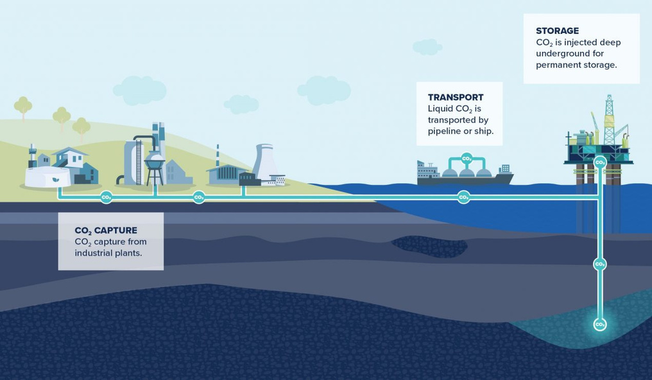
CCS: CARBON CAPTURE & STORAGE
Three Major Steps/Phase in CCS:
- Capture: CO2 is separated from other gases at large industrial facilities.
- Transport: The separated CO2 is compressed and transported to a storage site.
- Storage: CO2 is injected deep into rock formations at carefully selected sites for permanent storage.
CCS can significantly reduce CO2 emissions, making it a key option for mitigating greenhouse gas emissions.

Slide 6

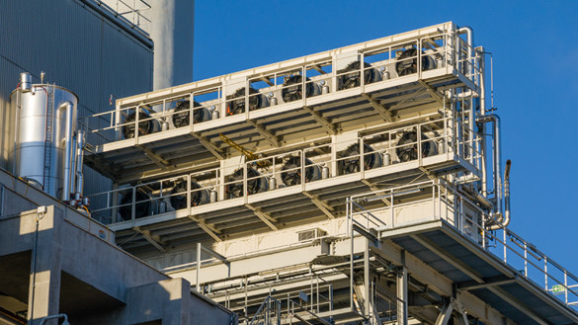
CAPTURE PHASE
During the capture phase, CO₂ is separated from other gases produced at large industrial facilities, such as steel mills, cement plants, petrochemical facilities, and coal and gas power plants, or directly from the atmosphere. Several capture methods are in use, each proven and effective, with different methods applied based on the emissions source
Methods: Includes pre-combustion, post-combustion, and oxy-fuel combustion.
Applications: Commonly used in coal and natural-gas-fired power plants, steel mills, cement plants, and refineries.

Slide 7
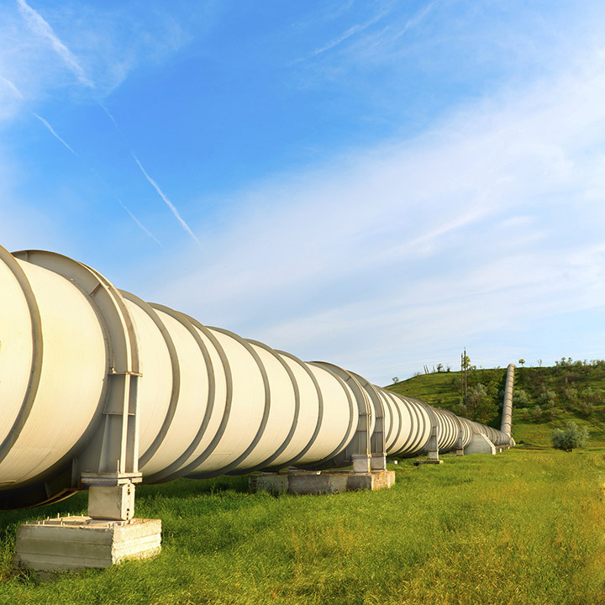
TRANSPORT PHASE
Once separated, the CO₂ is compressed for transportation by increasing pressure so that the CO₂ behaves like a liquid. The compressed CO₂ is then dehydrated before being sent to the transport system. Pipelines are the most common mode of transport for large quantities of CO₂, but CO₂ transport by ship is an alternative for some regions.
Transport Methods:
Pipelines (most common)
Trucks
Ships
Process:
CO2 is compressed for transportation.
Ensuring safety and having the necessary infrastructure are critical for effective transport.

Slide 8
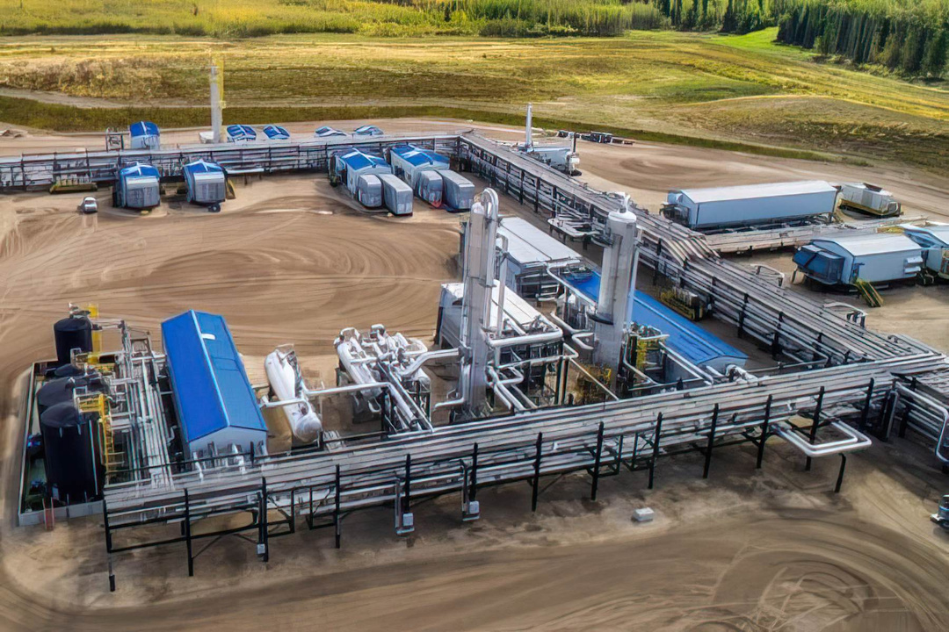
STORAGE PHASE
After transport, the CO₂ is injected into deep underground rock formations, often at depths of one kilometre or more, where it is safely and permanently stored. These rock formations are similar to those that have held oil and gas underground for millions of years. To date, nearly 300 million tonnes of CO₂ have been safely and successfully injected underground. Fortunately, there is an abundance of storage capacity available around the world.
Storage Process:
Geological storage involves the injection of captured CO₂ into rock formations, known as storage formations, typically at depths greater than 1 kilometer beneath the Earth's surface. This method effectively and permanently removes CO₂ from the atmosphere.

Slide 9
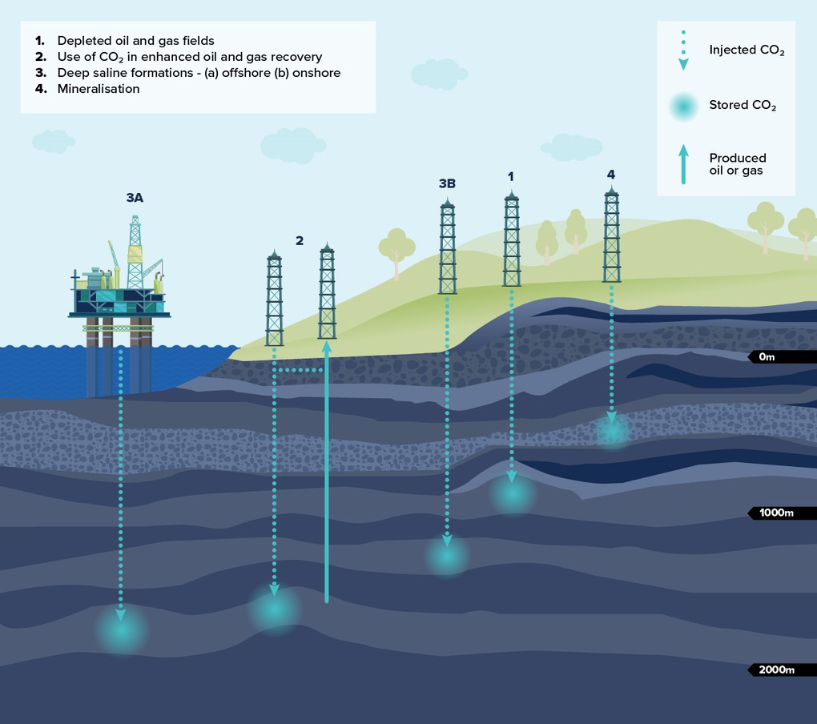
Storage formations possess several critical characteristics:
1. Porosity: These formations contain millimeter-sized voids or pores, which provide the necessary capacity to store substantial volumes of CO₂.
2. Permeability: This geological feature ensures that the pores within the rock are sufficiently interconnected. High permeability is essential as it facilitates the injection of CO₂ at the required rates, allowing the gas to disseminate effectively throughout the formation.
3. Permanence: Effective geological storage relies on the presence of an extensive cap rock or barrier encompassing the storage formation. This cap rock is crucial as it acts as a seal, ensuring that the CO₂ remains contained and permanently.

Slide 10
CCS STARTED IN 1972 IN TEXAS WITH NATURAL GAS PLANTS.
AS OF 2022, THERE ARE 194 LARGE-SCALE CCS FACILITIES WORLDWIDE.
EXAMPLES INCLUDE THE ZERO CARBON HUMBER PROJECT (UK) AND THE CITRONELLE PROJECT (U.S.).
CO2 CAPTURE CAPACITY OF ALL CCS FACILITIES UNDER DEVELOPMENT GREW TO 244 MILLION TONNES PER ANNUM IN 2022.

Slide 11
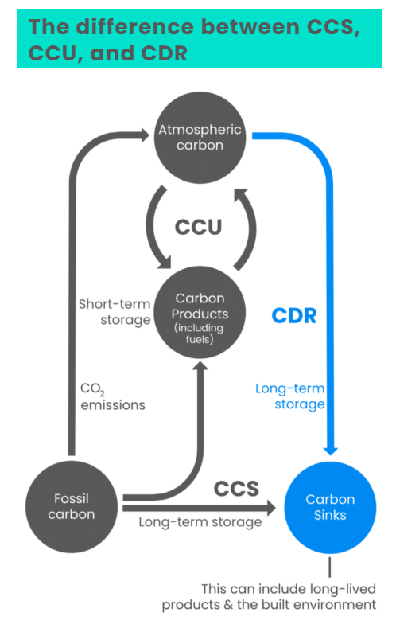
CCS VS CCUS
Carbon Capture, Utilization, and Storage (CCUS) is an advanced iteration of the traditional Carbon Capture and Storage (CCS) technology. While CCS primarily focuses on capturing and sequestering carbon dioxide (CO₂) to mitigate emissions, CCUS goes a step further by finding practical applications for the captured carbon. This makes CCUS a more dynamic approach, as it not only reduces the greenhouse gases released into the atmosphere but also converts them into valuable products like chemicals, concrete, and even fuels.

Slide 12
CCS
CCUS
Involves capturing CO₂ from large industrial sources and power plants, transporting it, and injecting it into deep geological formations for long-term storage. The primary goal is to prevent CO₂ from entering the atmosphere.
Includes all the steps of CCS but adds a utilization phase where the captured CO₂ is used in industrial processes or converted into commercially valuable products.Examples of CCUS include using CO2 in plastics, concrete, and biofuel production.

Slide 13
THANK YOU

